Slide 1
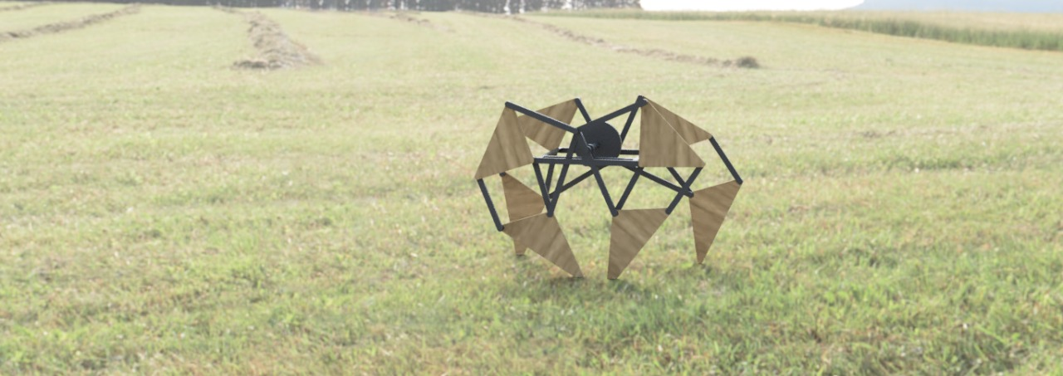
Just A Robot
A walking robot Module

Slide 2
PROBLEM STATEMENT
To design a walking robot module, which can be fitted with different parts of diverse functionalities based on consumer needs.
The market is wide open for a product which is module based. Such a product caters to a niches over a diverse range. In addition, it’s a novelty and can be marketed as such.

Slide 3
Concept Selection
Walking robots are of great value to researchers for their ability to move over rough or uneven surfaces with ease, compared to their counterpart, i.e. wheels.
By using a Pugh matrix and brainstorming for available solutions, Jansen’s Leg Mechanism as selected by us.

Slide 4
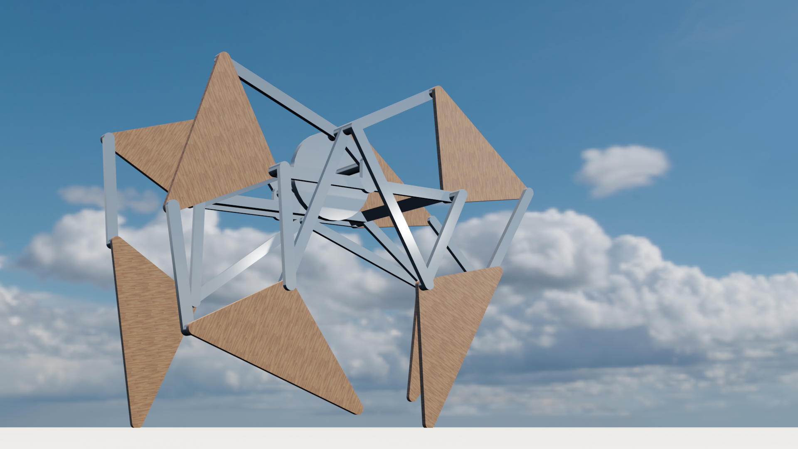
Mechanism
The module is made up of 4 leg systems, and legs on same are paired to a common crank link, but out-of-phase by half a rotation.
The central frame is simple in design, and can bear heavy loads.
The orbit of the foot determines the various factors of the module movement.
The movement is periodic in nature.

Slide 5
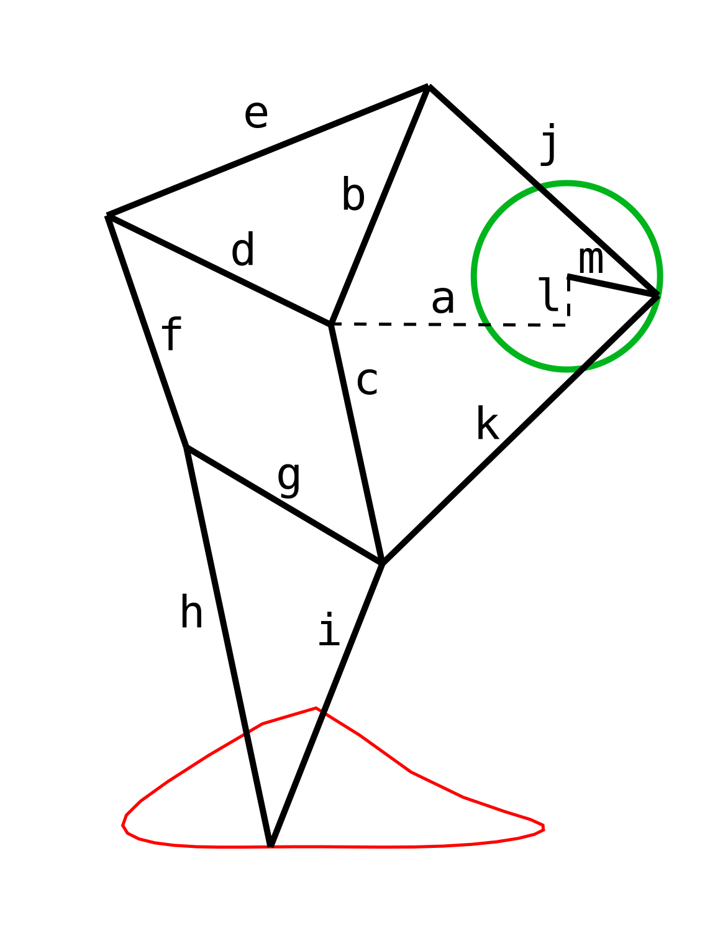
Dimensions Used (in cm)
a = 7.30769230769231
b = 7.98076923076923
c = 7.55769230769231
d = 7.71153846153846
e = 10.7307692307692
f = 7.57692307692308
g = 7.05769230769231
h = 12.6346153846154
i = 9.42307692307692
j = 9.61538461538462
k = 11.9038461538462
l = 1.5
m = 2.88461538461538
Thickness of each bar = 5mm

Slide 6
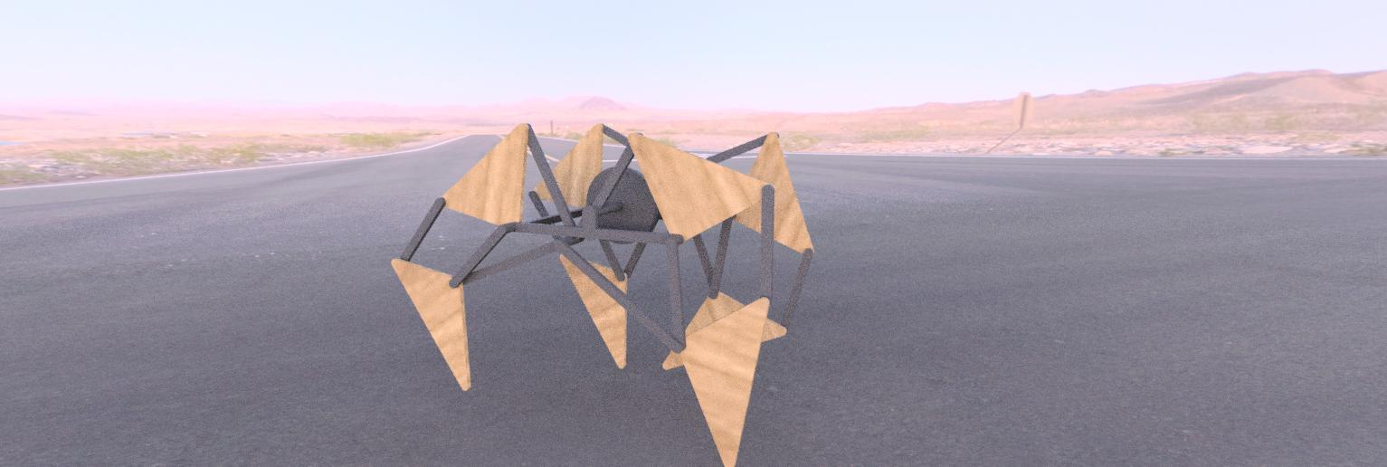
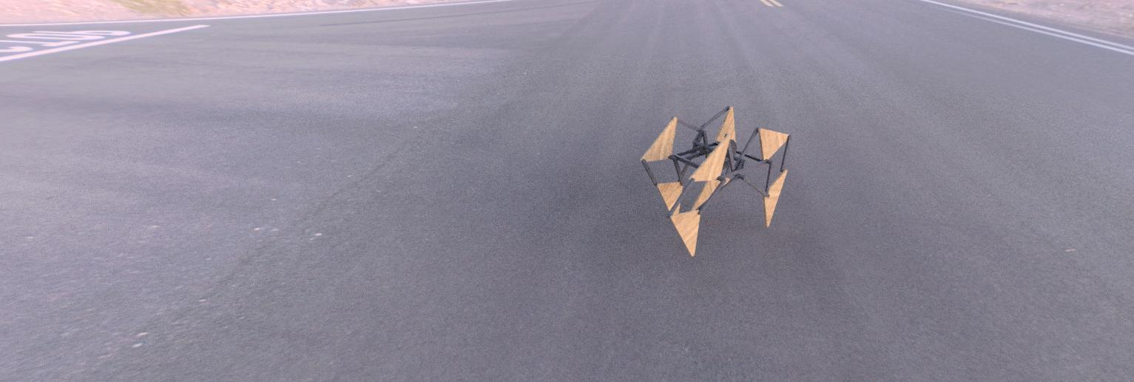

Slide 7
Cost Estimation
Material used: Stainless Steel
Cost/kg of steel: Rs 170
Thickness of bar = 0.3mm
Width of the bars = 1cm
Volume of each leg = 51.94cm3
Density of steel = 8.05 g/cm3
Weight of each leg = 250.87 g
Weight of the crank = 105.24 g
Distance between each parallel leg = 8 cm
Weight of the robot = Weight of (legs + crank + other bars ) = (250.87*4 + 105.24 + 128) = 1,236.72 g
Cost of the robot = Cost of steel + Cost of motor = 210 + 160 = Rs 370 (approx.)

Slide 8

Static Analysis
Stress analysis by ANSYS

Slide 9
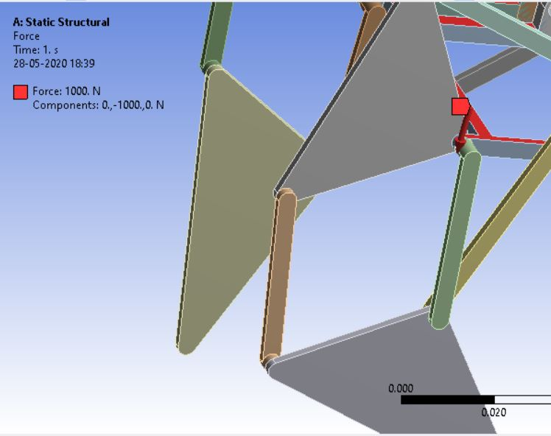
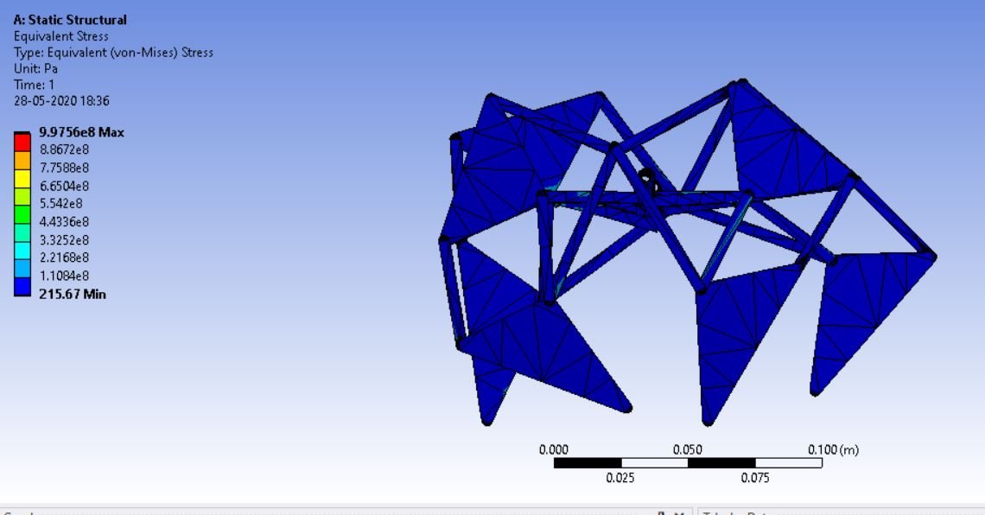
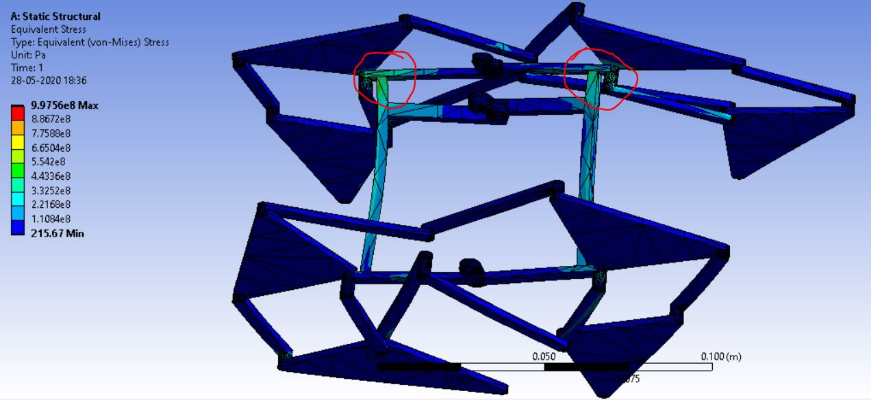

Slide 10
Kinematic Analysis

Slide 11
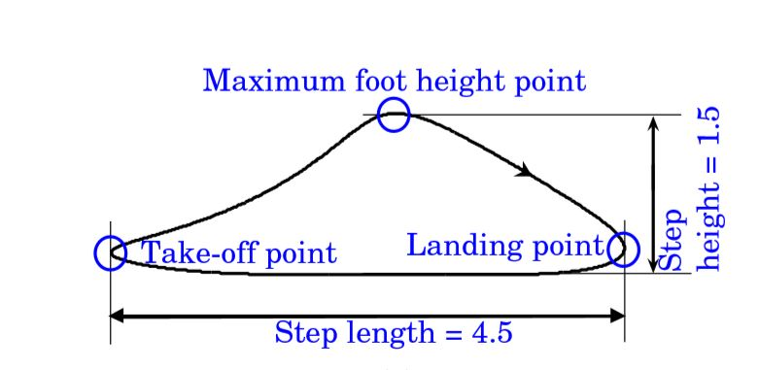
Position Analysis for a Jansen mechanical leg has been done using loop closure method and calculating the various parameters, given initial parameters.
This analysis is used to find the locus of the outcome of the leg i.e. the path drawn by the foot of the leg.
The analysis is also useful in calculating the velocity and acceleration of each node of the leg throughout one full crank rotation.

Slide 12
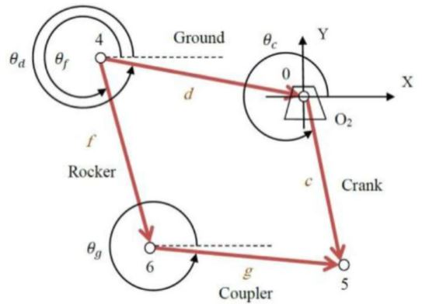
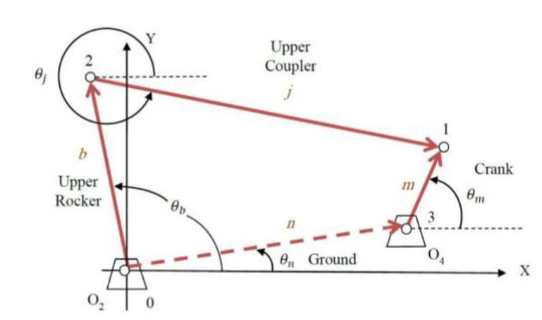
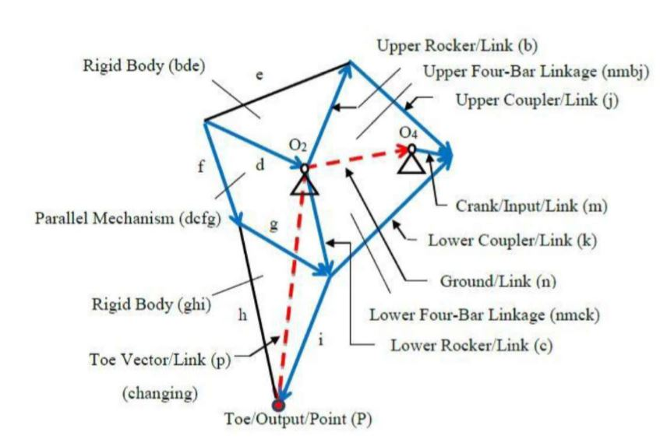
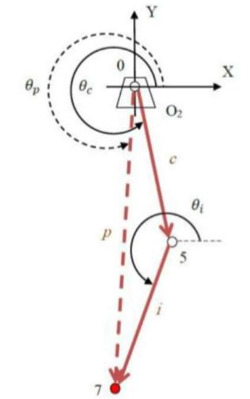
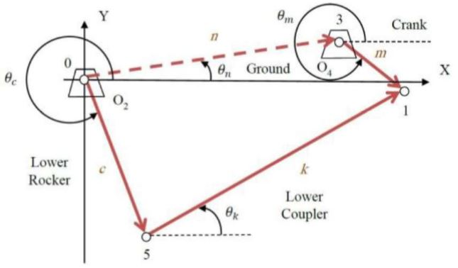

Slide 13
Concepts Utilised
Position Analysis
Loop Closure Method
Stress Analysis

Slide 14
Just A Robot Creators
Sri Ram K – Stress Analysis, Report writing, Kinematic Analysis, Brainstorming, PowerPoint presentation, Model Rendering
Faseeh Ahmed – Report Writing, Brainstorming, CAD model design in Fusion 360, Model rendering, PowerPoint presentation
Shaheel P – PowerPoint presentation, Brainstorming, CAD model design in Fusion, Model Dimension calculations
Abhinand P – Pugh Matrix, Stress Analysis, Kinematic Analysis

